Slide 1
Math 12 Honors CH4 Practice Test Review

Slide 2


First, recognize that this equation is quadratic. So make a substitution for A= tan2Ø
Because of the horizontal compression, the period of the tangent function is $\frac{π}{2}$. So this means that there will be twice the number of cycles from 0 to 2 $π$
Remember to treat 2Ø as a single angle first. Ie: Use B=2Ø. Then use cast find out which quadrant “B” is in.
IF tanØ is negative, the angle will be in quadrants 2 and 4
IF tanØ is positive, the angle will be in quadrants 1 and 3

Slide 3

Since B=2Ø, now we use algebra to solve for Ø
Repeat!!
Repeat!!
Add the period again to get all the answers between 0 and 360!!!
Remember that there was a horizontal compression at the beginning. That means we need to add the period to get the solutions for the next cycle.

Slide 4

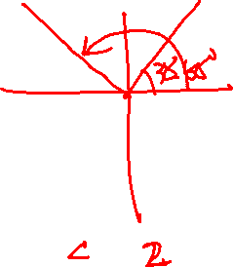
Here are all the things that you need to keep in mind when solving trig equations
1. There’s a horizontal compression by a factor of 3. This means that between 0 and 360, there will be 3 CYCLES of answers!! So we have 6 answers in total
2. With a H.C. by a factor of 3, the period will now be 120 degrees. (360/3=120). So to get the solutions in the 2nd and 3rd cycles, add the period until all your answers are between 0 and 360
3. Csc (x) is the reciprocal of sin(x). After we solve for csc(x), take the reciprocal of the ratio and make it equal to sin(x)
4. Make sure you treat 3Ø as a single angle first, ie: B= 3Ø. Use CAST to solve for “B”, then use algebra to solve for Ø

Slide 5
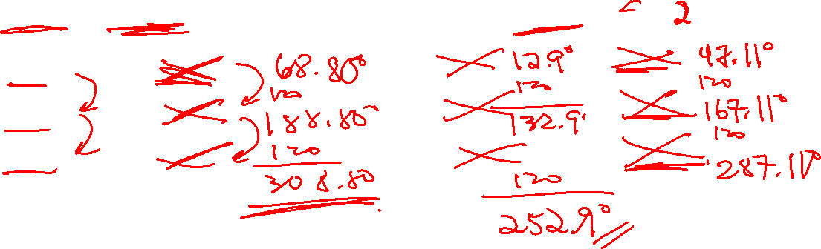

Slide 6

1. Before you graph the equation, simplify it by making sure that the coefficient of “x” is 1. So factor out the
“-2” outside of the brackets!!!
2. Since “B” is negative, we have a horizontal reflection. Remember that cosine is an “EVEN” function, where cos(-x)=cos(x). So the H.R. can be removed
3. Now find “A” [amplitude], “B” [H. C/E], Period [p=2pi/B], “C” [phase shift], “D” [Ver. Shift]

Slide 7
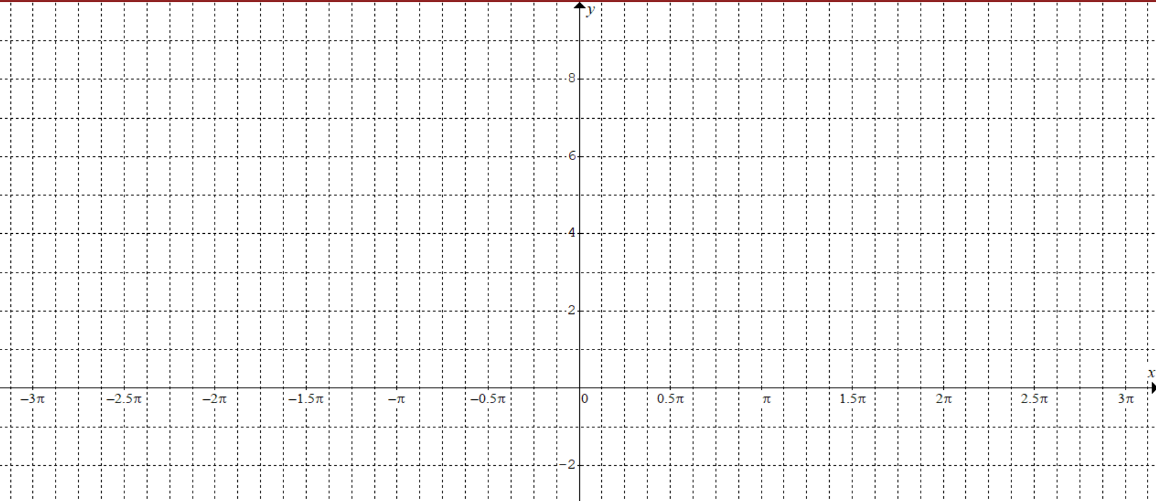
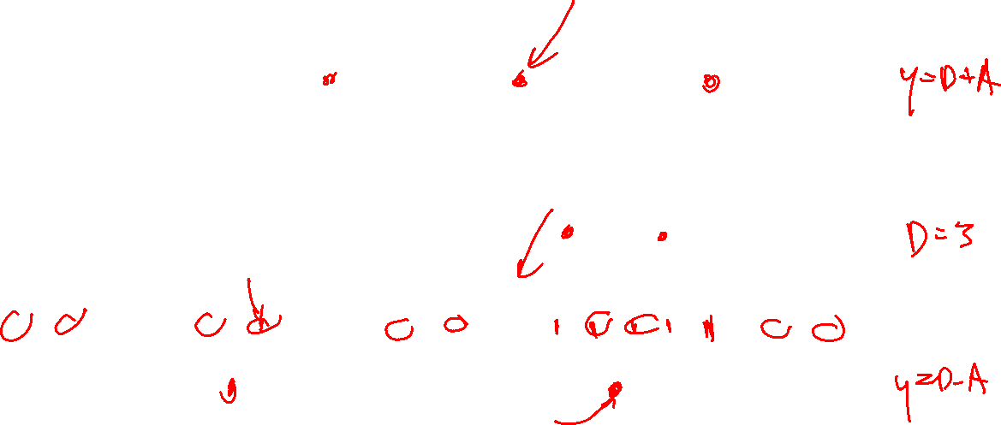
Every 2 increments is equal to pi/4.
Since it’s a cosine graph, the cycle starts at the top and ends at the top
The period of 5pi/4 is equal 10 increments.

Slide 8

To find the Maximum points, first get the max height for the Y-coordinate. Y = 8
To get the “x” coordinates, get the first one, then add the period to find the rest….
To find the “x” intercepts, make Y=0 and then algebraically solve for “x”
Solve for “x” in RADIANS!!!!!

Slide 9
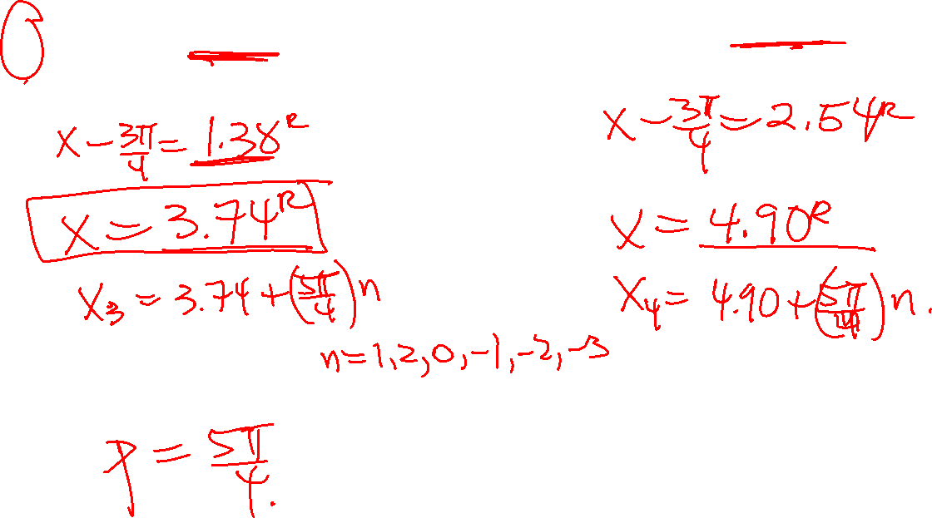

Slide 10
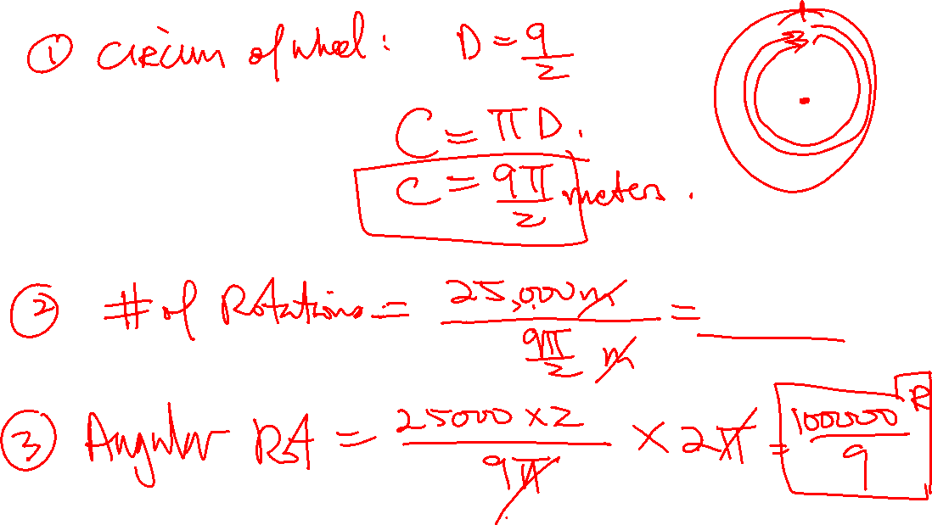

Slide 11
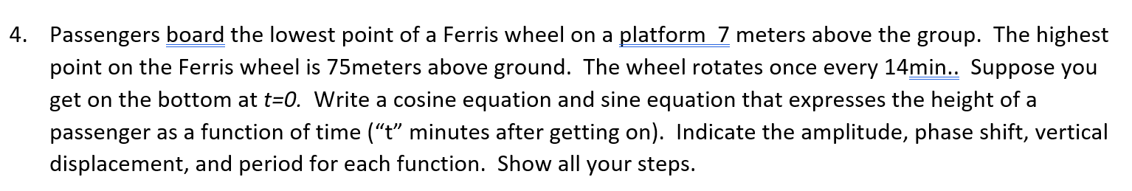
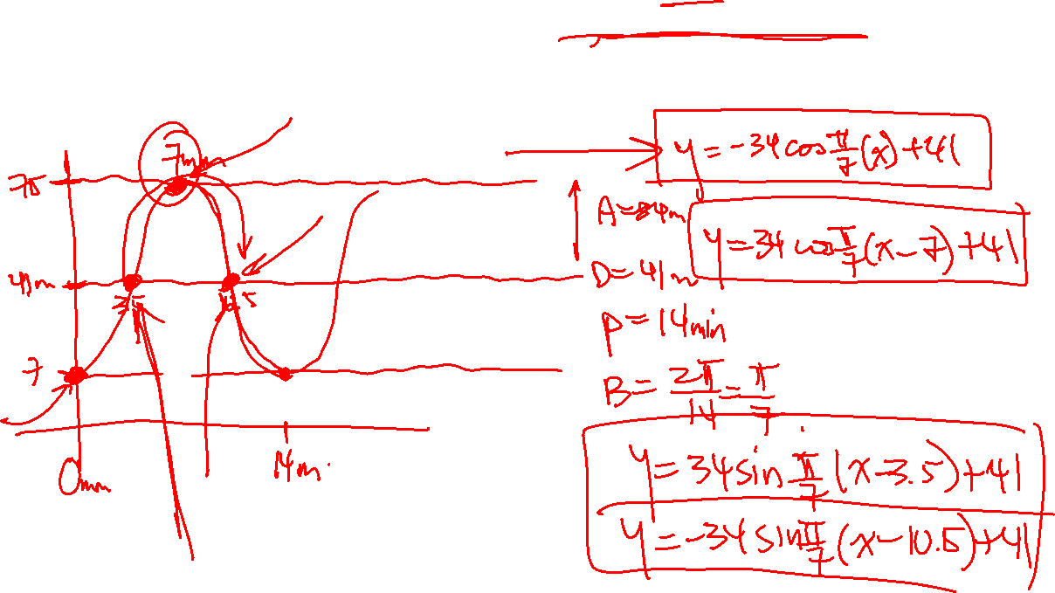

Slide 12
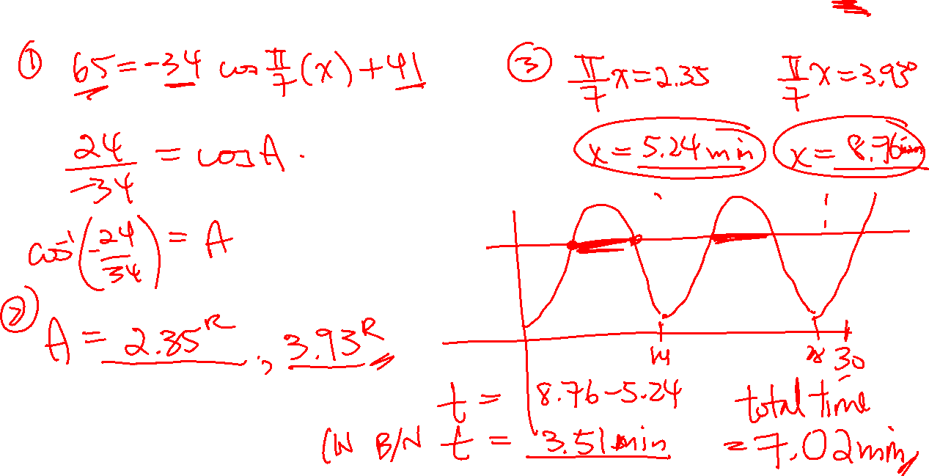

Slide 13
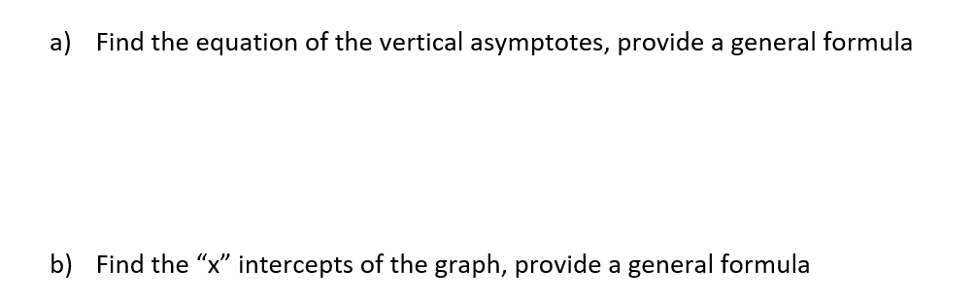
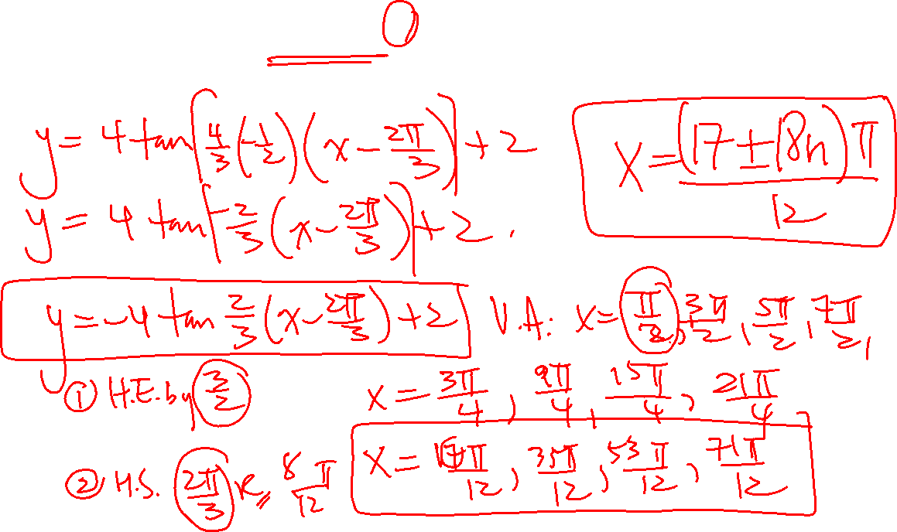

Slide 14
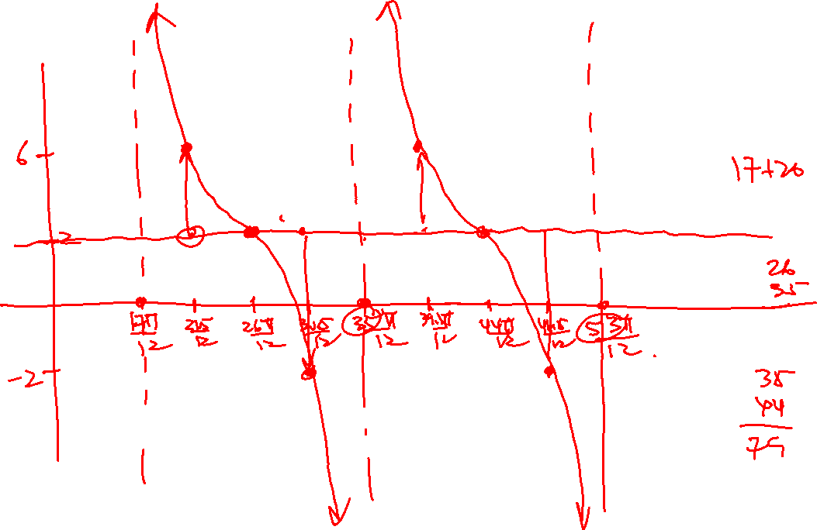

Slide 16
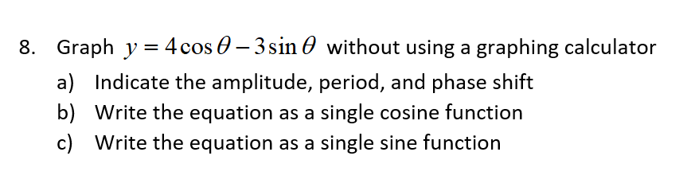
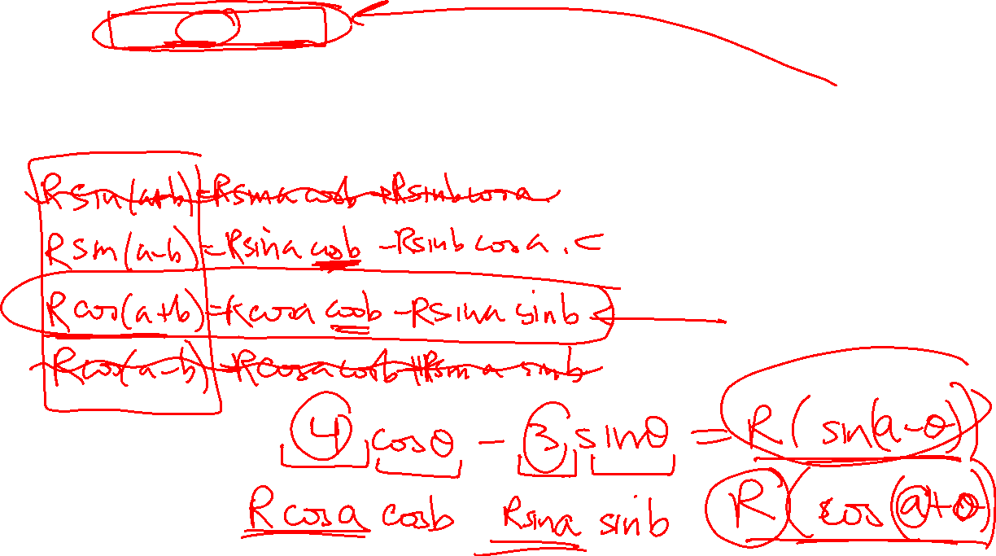

Slide 17
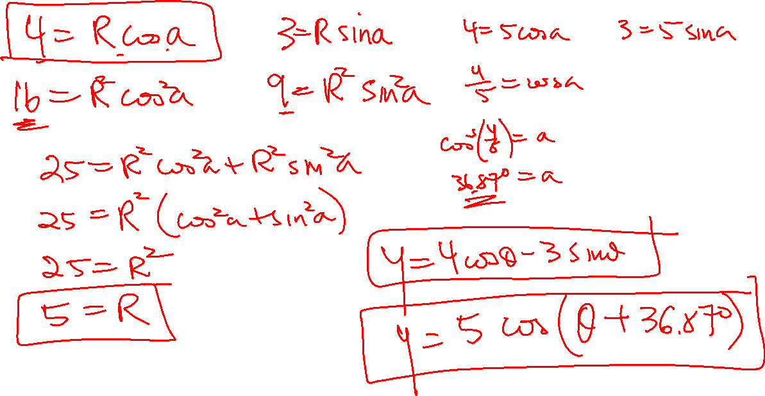

Slide 18
